Slide 1
Professional Skills
CCLA Peer Consultant Training

Slide 2
How to Write an Email

Slide 3
Netiquette: Do’s & Don’ts
Don’ts:
Do’s:
Keep messages short & sweet
Email like a text message
Respond don’t react
Use all caps
Re-read before sending
Present personal opinions as facts
Avoid slang, jargon, sarcasm
You may encounter emails that seem angry or that may anger you. It is important to respond to the email and not react to the email. What we mean by this is not responding to an angry email with more anger.
Take a moment(s) to either calm down or to craft a response. If you are unsure on how to craft a response, contact your supervisor and ask for some assistance!
You never know who your email may be forwarded to and who will be reading your email.
This will help to catch anything you need to add or something you didn’t want to add!
You may also want to check for the following:
Grammar & Punctuation Errors
Poor Sentence Structure
Incorrect use of tenses
Spelling errors/typos
There is nothing that goes unread like a long email. If having to write a long email please make sure to break it up and make it as accessible as possible.
Add some color, maybe a few bullet points, etc.
This gives the impression that you are yelling. Use caps as headings etc. Do not write long lengths of text in caps. If you are trying to get a point across bolding and changing the color can be more impactful.
Do not use slang, jargon, or sarcasm when sending emails. This makes the email not easily accessible for everyone as well as it just does not make for a good email.
Stay neutral as much as possible when emailing, especially when collaborators are frustrated with the issues they are running into.
Emails are considered the professional way to communicate and should be treated as such.

Slide 4
Elements of an Email
TO, CC, & BCC
Subject
Greeting
Body
Sign-off
Signature

Slide 5
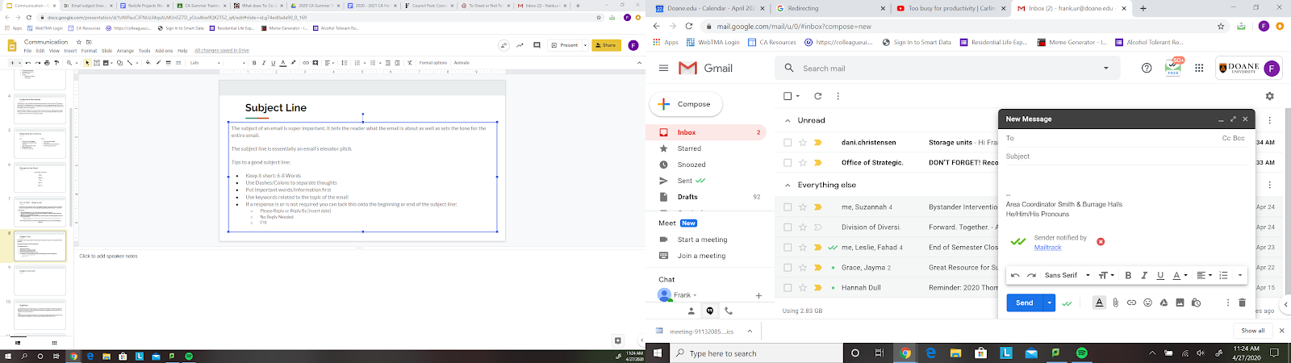
TO, CC, BCC
“If someone is a primary recipient of an email and is expected to respond, they go into the ‘To’ field. If someone is not a primary recipient of an email and is not expected to respond, they go into the ‘CC’ field.” ~ Victoria Turk
Different Fields :
TO: Email address goes here if it is for their attention and requires their response
CC: Use this field if copying people on information and not necessarily needing a response, but everyone should know who is aware of the information
BCC: Put email addresses here if you are sending information that does not require a response and/or if you are sending an email with many recipients
This is useful in sending an email with recipients who do not want their emails shared

Slide 6
Subject Line
The subject of an email is super important. It tells the reader what the email is about and sets the tone.
The subject line is essentially an email’s elevator pitch and should give the reader a reason to open it.
Tips to a good subject line:
Keep it short: 6-8 Words
Use dashes and colons to separate thoughts
Put important words and information first
Use keywords related to the topic of the email
If a response is or is not required you can tack this onto the beginning or end of the subject line:
Please Reply or Reply By [insert date]
No Reply Needed
FYI

Slide 7
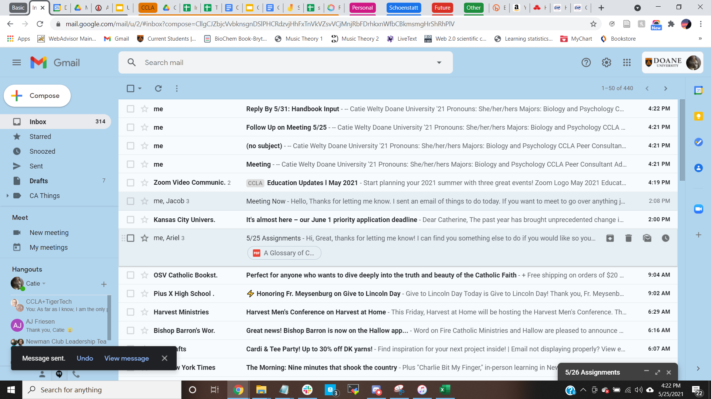
Subject Line Cont.
Bad Subject Lines:
Meeting:
In the world of emails the receiver of an email most likely has many meetings scheduled. This email could be requesting a meeting or following up on a meeting. There are no specifics.
(no subject):
This provides no information as to what the email is and what the reader should be aware of prior to opening the email.
This could easily be marked as unimportant or simply moved to the trash.
Improved Subject Lines:
Follow Up on Meeting 5/25
This subject lines expresses exactly that the viewer is about to read an email regarding a meeting they were at and knows what to most likely expect to read.
Reply By 5/31: Handbook Input:
This subject line gives a due date for an expected reply.

Slide 8
Greetings
A greeting defines the tone and intent of the email, it is typically the first thing that is read (after the subject line). Examples may include: Hello, Hi, Dear.
These three are simple and always a good go to if you are not familiar with the person you’re communicating with.
Titles: When in doubt of how to address someone's title in an email take a look back on previous communication you may have had and see how they sign off or what they include in the “signature” portion of their email.
Greetings/Opening Lines:
Can be kept very simple and to the point.
Not having a greeting can automatically make an email seem demanding/terse.
You do not always need to see how someone is doing.

Slide 9
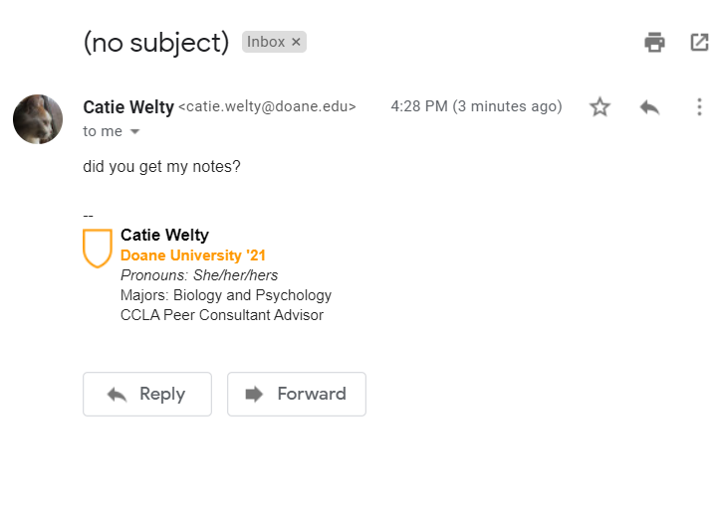
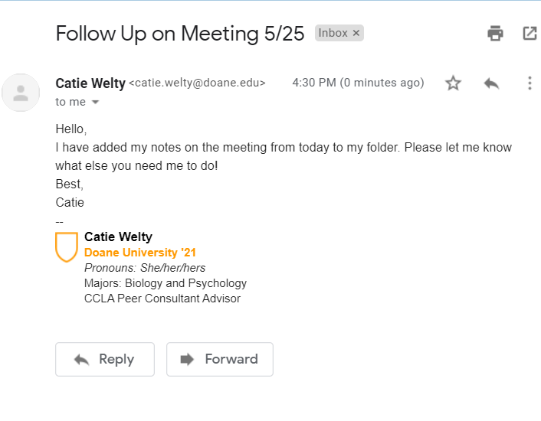
Greetings Cont.
Email With No Greeting:
Email With A Greeting:
Comes off as very demanding and impersonal.
There are no coherent thoughts and would require a follow up email with clarifying questions.
The writer is addressing the reader and does not come off as demanding.
The emails reads as coherent and with full sentences.
The intent of the email is clear and would not be confused.

Slide 10
Body
The body of the paragraph is the whole reason you are sending an email. It’s the meat and potatoes. This information should be accessible, easy to read, and to the point. Most importantly the body of the email should be coherent and in complete sentences.
Sending an email is not the same as sending a text.
The body of the email should include:
Who, what, where, when, why: This is all crucial information to provide context.
Specifics: Always provide specific detail if you can, such as dates/times.
Clear and concise thoughts.

Slide 11
Body Cont.
Bad Body:
Good Body:
There are no details as to what notes the sender is asking about.
A follow up email with clarifying questions would be needed.
This email is clear and concise.
It is detailed and in complete sentences.

Slide 12
Sign-Off
A sign-off can be one of the most stressful parts of an email as you can sit there and think through all the various possibilities. Here are some examples:
“Best,”: It is simple yet professional. You may also see this as “Best regards.” These are traditional and typically the “safe” sign off, even in professional emails.
Using “Sincerely,” can be professional but it quite outdated and is used more for very formal correspondences.
“Thank You,”: This one is a good one, but be careful. Depending on the context of an email it can be read as a bit demanding.
EX: If requesting information and you put a “Thank You” at the end it is implying that you are thanking the respondent as if they have already given you the information.
Beware of “Thanks!” Only use this when actually thanking someone for information they have provided. This can often be read as giving a direct order and can rub the wrong way.
Create your own: Sign-off depending on the context of the email and who you are sending it to. Some that could be used are:
Have a great day,
Stay safe,

Slide 13
Signature
A signature will change from email to email, position to position. There are some basics to include in your signature which are listed below. However, please keep in mind that your signature is not your resume. Keep it simple and need to know.
Basics to Include:
Name
The name can be a tricky one as sometimes the “signature” field on an email will not show up in an email and can appear as “...” at the bottom of the email. I personally recommend signing your name every time.
In an initial email you will always want to include your full name.
Position
Pronouns (Depending on the Job)

Slide 14
Boundaries

Slide 15
What are boundaries?
Boundaries are the way you tell others how they can treat you
This is how you set limits and communicate how you expect to be treated
Boundaries allow for clear communication between others
https://www.livewellwithsharonmartin.com/what-are-boundaries/

Slide 16
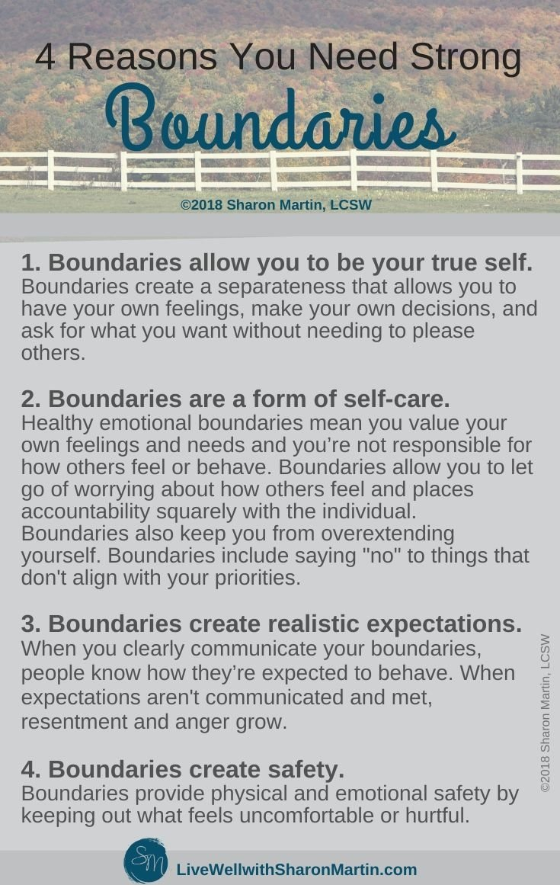
https://www.livewellwithsharonmartin.com/what-are-boundaries/

Slide 17
Active Listening

Slide 18
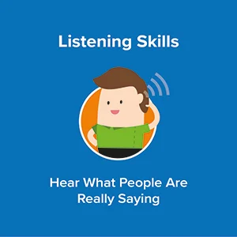
What is Active Listening?
Making a conscious effort to understand the complete message another person is communicating
“When you listen actively, you are fully engaged and immersed in what the other person is saying.”
https://www.verywellmind.com/what-is-active-listening-3024343

Slide 19

How to Actively Listen
Five techniques
Pay Attention
Show That You’re Listening
Provide Feedback
Defer Judgment
Respond Appropriately
https://www.mindtools.com/CommSkll/ActiveListening.htm

Slide 20
Pay Attention
Look directly at the speaker
Push away thoughts that may distract you
Don’t listen just to formulate a response
Try to bring the speaker to a calmer and quieter environment to reduce other distractions
Watch the speaker’s body language

Slide 21
Show That You’re Listening
Occasionally nod and make small verbal comments (‘yes” or “uh huh”) to encourage the speaker to continue
Use your facial expressions to react to what is being said
Ensure your posture is open and interested
https://www.mindtools.com/pages/article/Body_Language.htm

Slide 22


Dismissive posture
Engaged posture

Slide 23
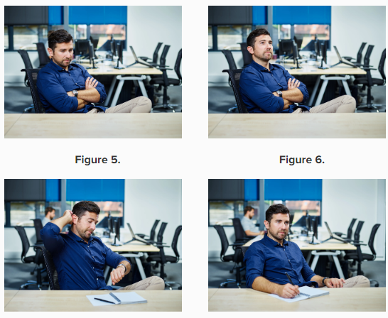
Looking at something else or gazing into space
Sitting slumped; downcast head
Examples of unengaged behavior
Fidgeting; playing with pens or phones
Writing or doodling (in some cases)

Slide 24
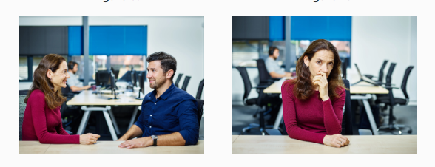
Maintain eye contact
Avoid touching your face

Slide 25
Provide Feedback
Ask questions about what is being said to clarify
Reflect on what has been said verbally through paraphrasing or nonverbally
Summarize what has been said occasionally

Slide 26
Defer Judgement
Allow the speaker to finish their point before commenting or asking questions
Avoid counter arguments unless the speaker has said they are ok with them
If you disagree with something that has been said, avoiding showing your disagreement outwardly

Slide 27
Respond Appropriately
Give your opinions in a respectful manner
Be open and honest when responding
Sometimes, the best response is to say nothing

Slide 28
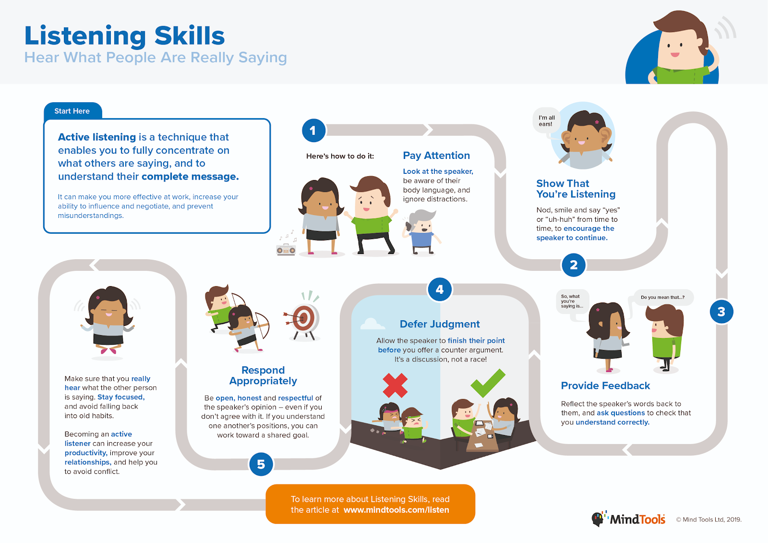
Notes:
For those who are visual learners

Slide 29
Sources
Information from the following sources:
the Mind Tools Content Team By the Mind Tools Content Team, Team, the M. T. C., wrote, B. T., & wrote, L. (1969, December 29). Active Listening: Hear What People are Really Saying. Communication Skills Training from MindTools.com. https://www.mindtools.com/CommSkll/ActiveListening.htm
Martin:, S. (2021, May 7). What Are Boundaries and Why Do I Need Them? Live Well with Sharon Martin. https://www.livewellwithsharonmartin.com/what-are-boundaries/

